Slide 1
Bora Lee
eGovFrameWork Web Application Course

Slide 2

01
INDEX
INTRO
MID PROJECT
Car Rental System
FINAL PROJECT
Academic Management
System

Slide 3

Intro
BORA LEE
Born in April 27, 1987
010-5031-7101
https://nikkiapril.wixsite.com/-nikkiapril
Completion of eGovFrameWork
Web Application Course
(Jan.16,2017 - Aug.8, 2017)

Slide 4
01
MID PROJECT – Car Rental System
April 10, 2017 ~ April 28, 2017(About 2 weeks)
Four members were participating to develop Car Rental System using JavaFx
Bizforms
www.bizforms.co.kr

Slide 5
Mid Project(Car Rental System)
Main function
I participated in
Login
Id/Pw
Management of Customer
Management of Car
Management of Employee
Management of Reservation
Management of Rent
Management of Equipment
Management of Buyer
Management of Insurance
Management of Sales
- Input & Output Data through Excel and Graph
Management of setting, packaging, interfaces, basic frameworks as an Application Architect
Configuration Management using SVN
Designing layouts using Java Fx
Building servers using RMI

Slide 6






Mid Project(Car Rental System)
TOOLS
Eclipse, SVN
JAVA, JAVA FX
iBatis
JDBC
Oracle 11g

Slide 7
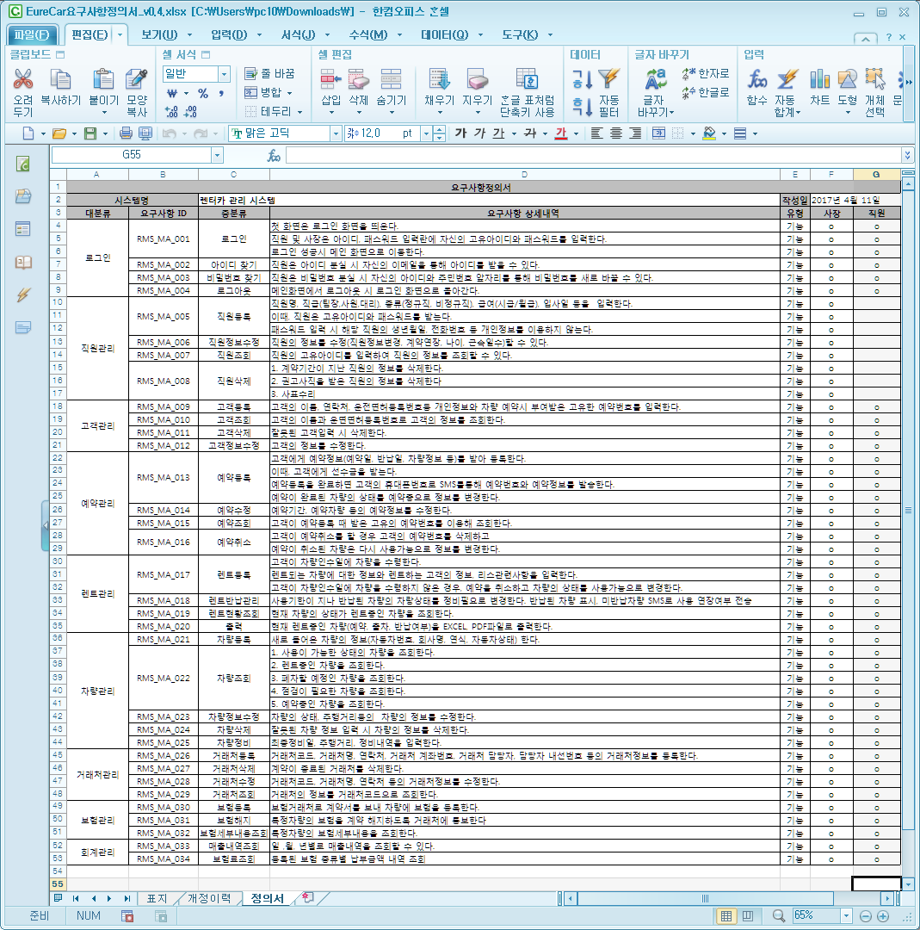
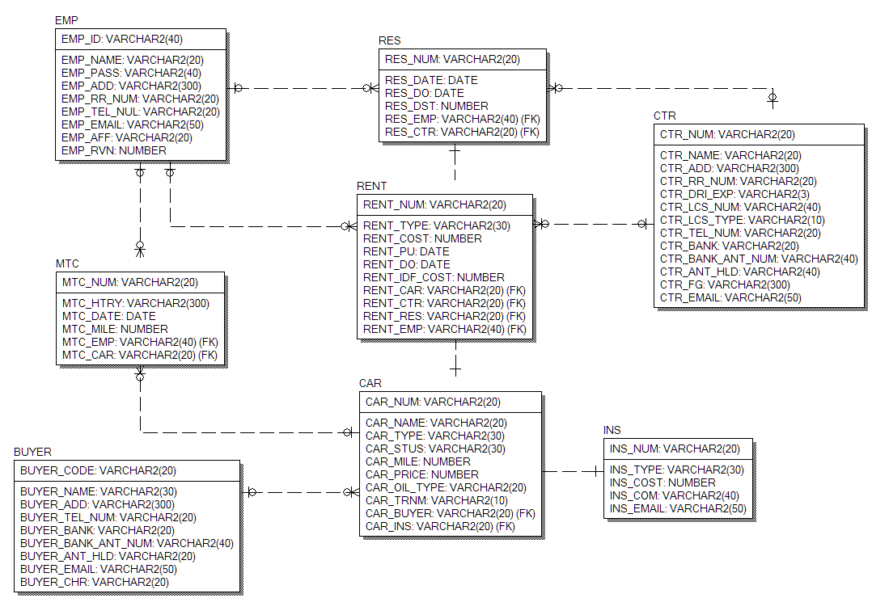
Car Rental System
Requirements analysis & ER diagram
1
2
Requirements Analysis
ER diagram
- Requirements from Clients
- Project plan within limited time
- Shortening project period by detailed requirements analysis
- Visualizing data model
- Definition of data type
- Analysis of Essential Data

Slide 8
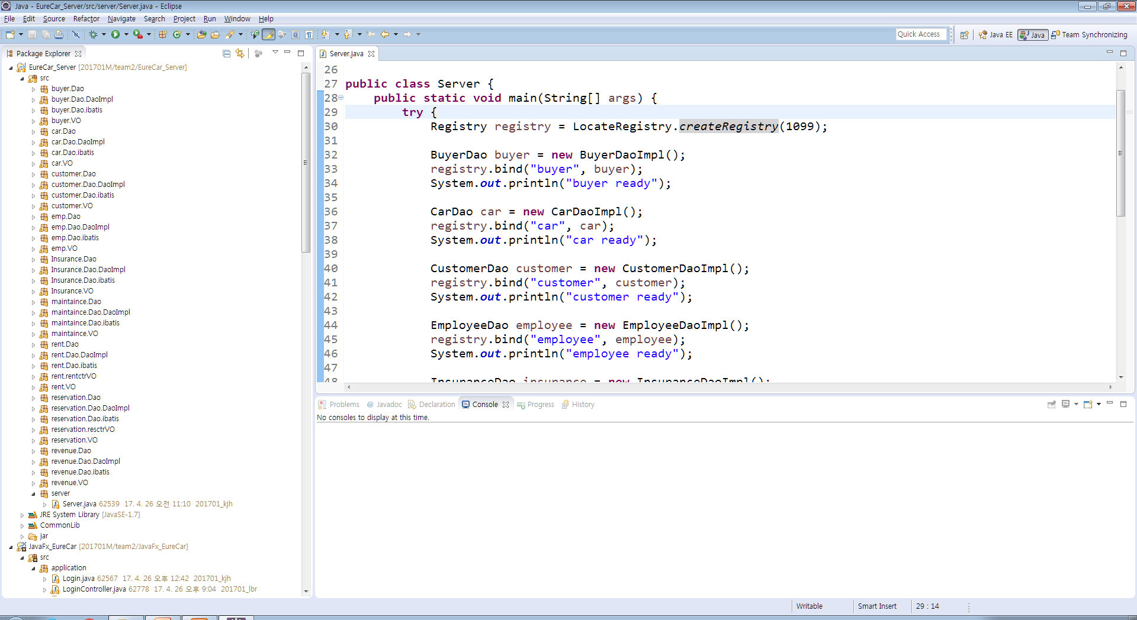
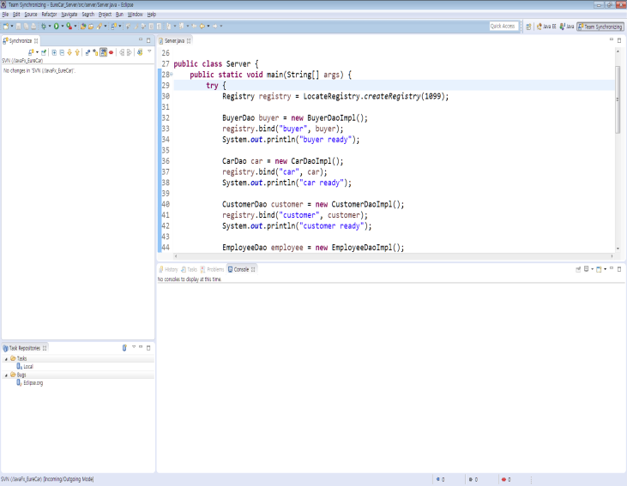
Car Rental System
Code using mvc and Singleton Pattern
3
4
RMI SERVER
SVN
- Creating stub to implement Server and Client
- Configuration Management by SVN

Slide 9

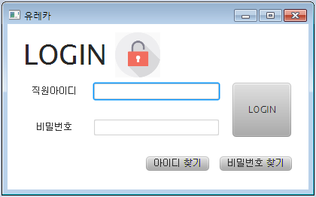
Car Rental System
Implementation (main and login, id, pw information)
Main and login pages
- Personal ID or PW is sent directly to user's e-mail
if '아이디찾기'(Find my id) or '비밀번호찾기(Find my pw)' is clicked
- Directly connected to the main page if inserted user data is correspond to existing user id,pw

Slide 10
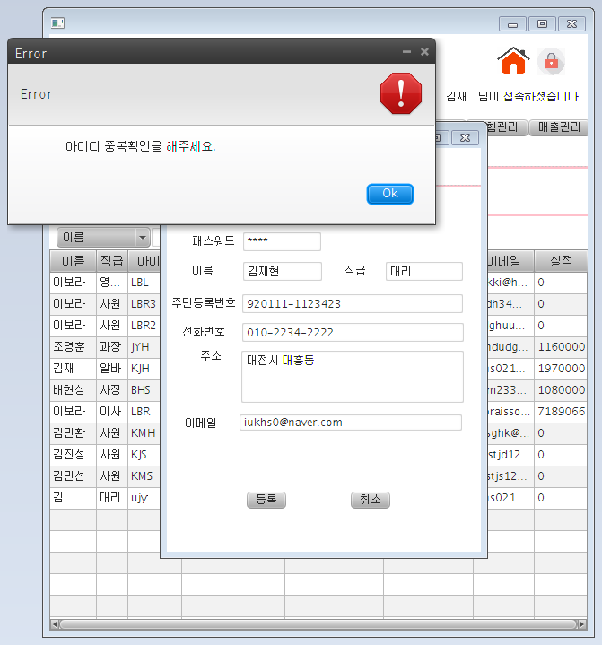
Car Rental System
Implementation (Management of Employee)
Management of Employee
Information of each employeed can be inserted, deleted, read,updated.
Data must be inserted in the regular expression

Slide 11
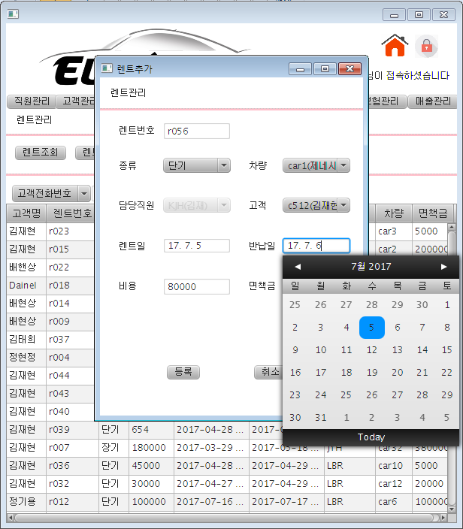
Car Rental System
Implementation (Management of rent & date picker)
Management of Rent
Management of car rental history(Create, Read, Update, Delete)
Data can be inserted based on car rental status and date picker is used to enable users to choose rental date for their convenience

Slide 12
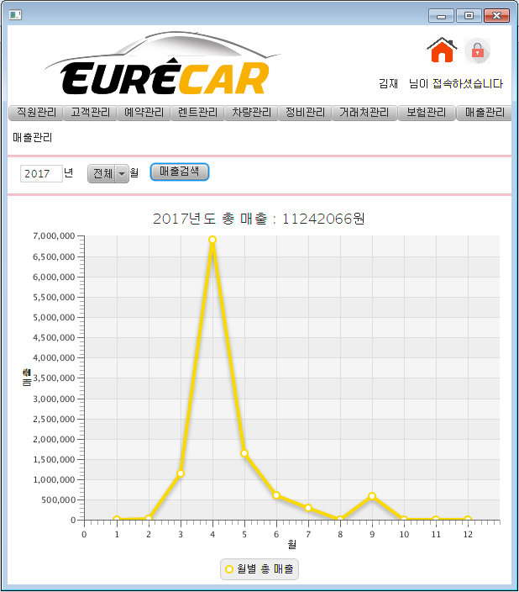
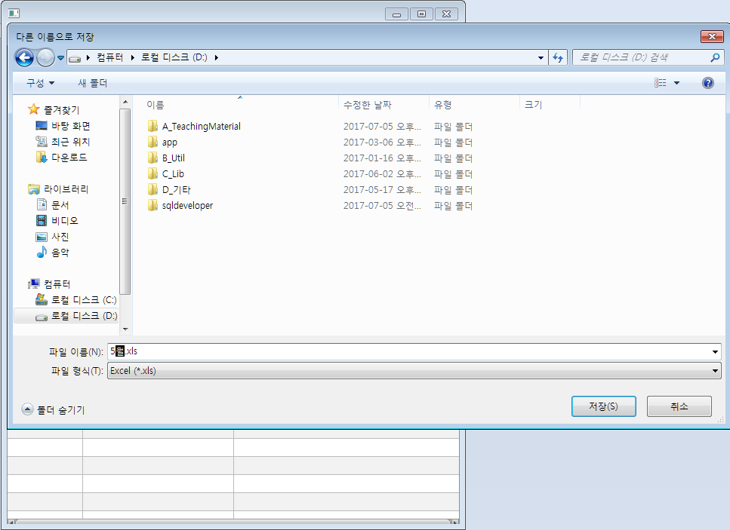
Car Rental System
Implementation of function (Sales Graph & Excel Output Data)
Management of Sales
It shows user monthly sales data by graph and detailed data can be downloaded in excel form

Slide 13
01
FINAL PROJECT
Academic Management System
June 28, 2017 - Aug 4, 2017 (About a month)
6 members participated in analysis of existing AMS, implementation of the main function, additional requirements analysis and implementation.
Bizforms
www.bizforms.co.kr

Slide 14
Final Project(Academic Management System)
PROJECT SUMMARY
Final Project (Acedemic Management System)
Main Function
I participated in
Tools
Security
Spring security, RSA Code System
Auto-logout, Secure coding
Responsive Web
Bootstrap
Convenience
Poi, iText, Google Chart
Full calendar
Technology Architect
Management of project plan and the document
Student Part
implementing main notice board parts and resolving errors
Config
Spring security, tiles
Maven, mybatis
Applying API
STS, Git
JAVA, MAVEN
myBatis
Oracle 11g
Tiles, Bootstrap

Slide 15








Final Project(Academic Management System)
Tools
Eclipse, Git
JAVA, JSP
myBatis
SPRING
Oracle 11g
TILES
APACHE TOMCAT

Slide 16


Final Project(Academic Management System)
Remote Configuration Management
Project Layout
Another API and tools I used
File Upload and Download
Management of Schedule

Slide 17
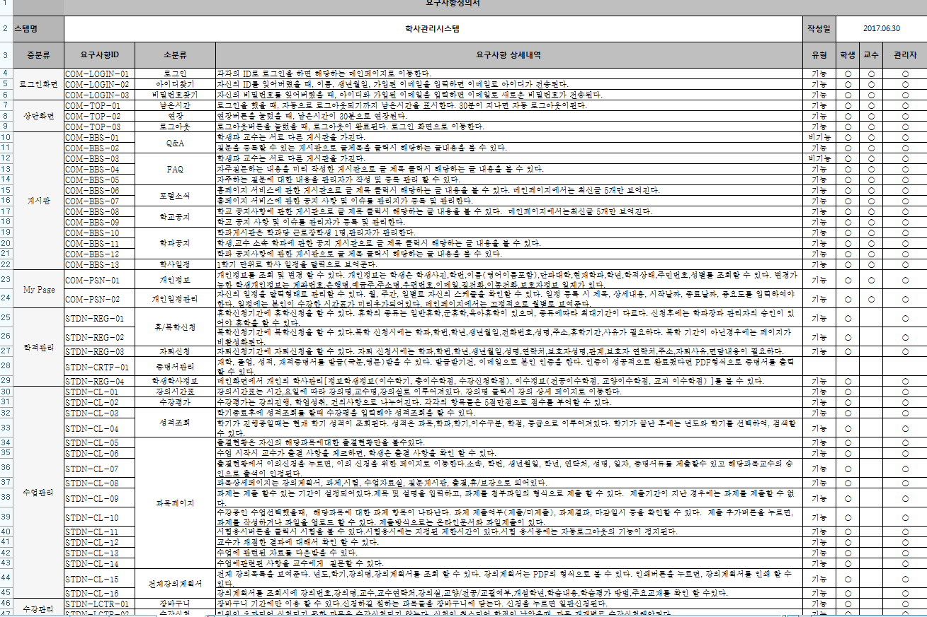
Final Project(Academic Management System)
Academic Management System
요구사항 정의서
1
Requirements Analysis
- Requirements from Clients
- Project plan within limited time
- Shortening project period by detailed requirements analysis

Slide 18
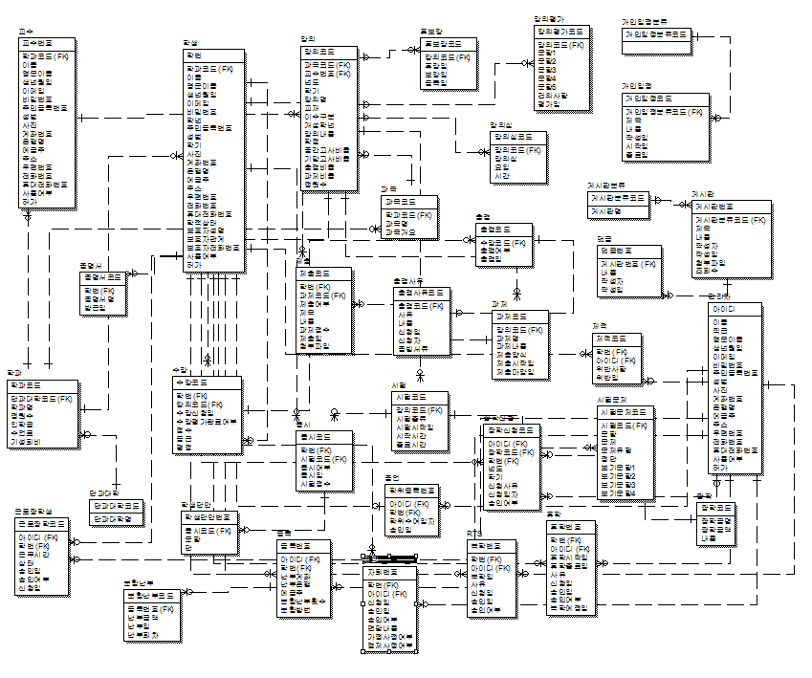
Academic Management System
요구사항 정의서
2
ER-DIAGRAM
- Visualizing Data Model
- Information Type Definition
- Analyzing required information and data

Slide 19
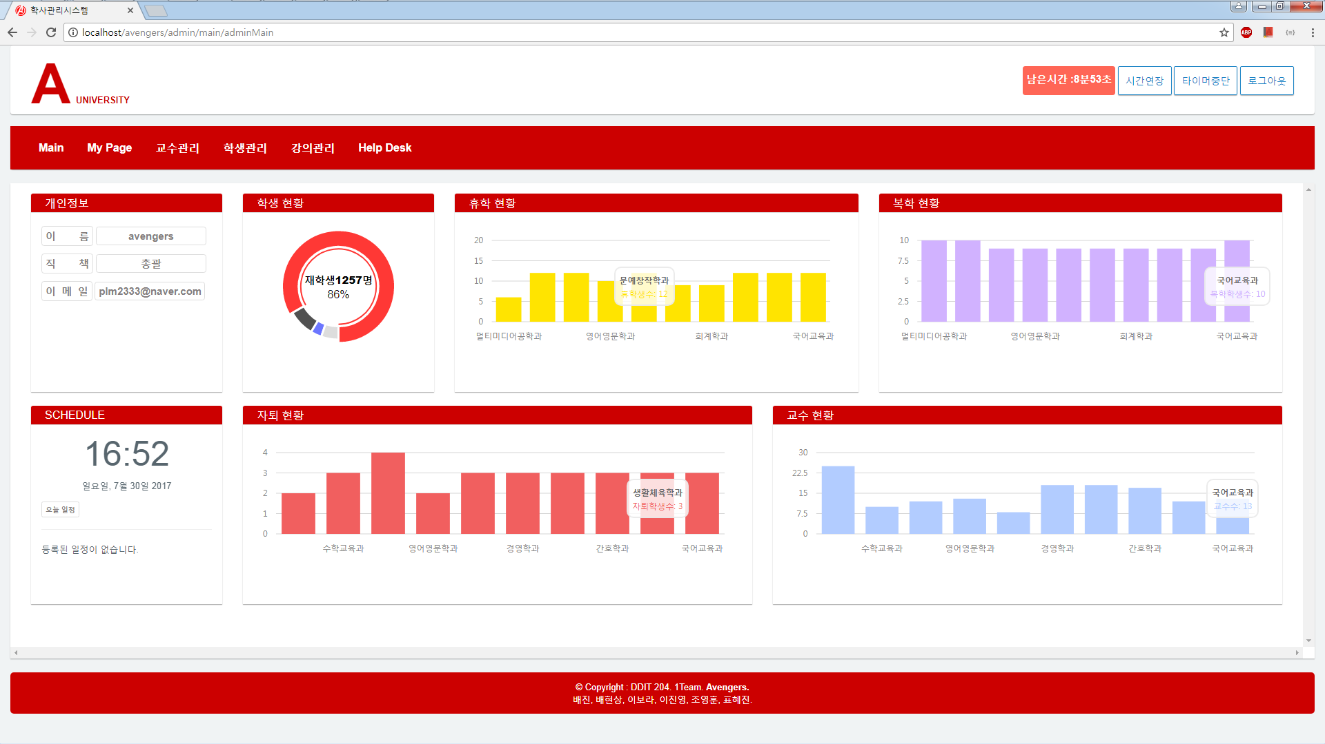
Manager
Academic Management System
3
MAIN(Manager View)
- Auto logout using Java script.
- Chart with graph shows current status of students, department, Academy situation.

Slide 20
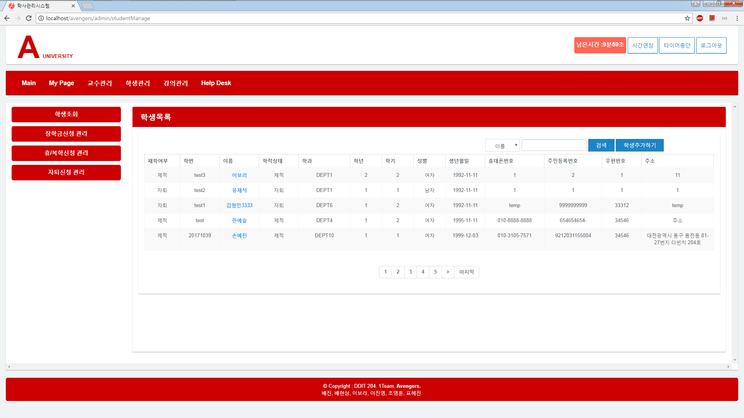
Manager
Academic Management System
4
Management Board
- Board of student, department, portal with Paging, Search function

Slide 21
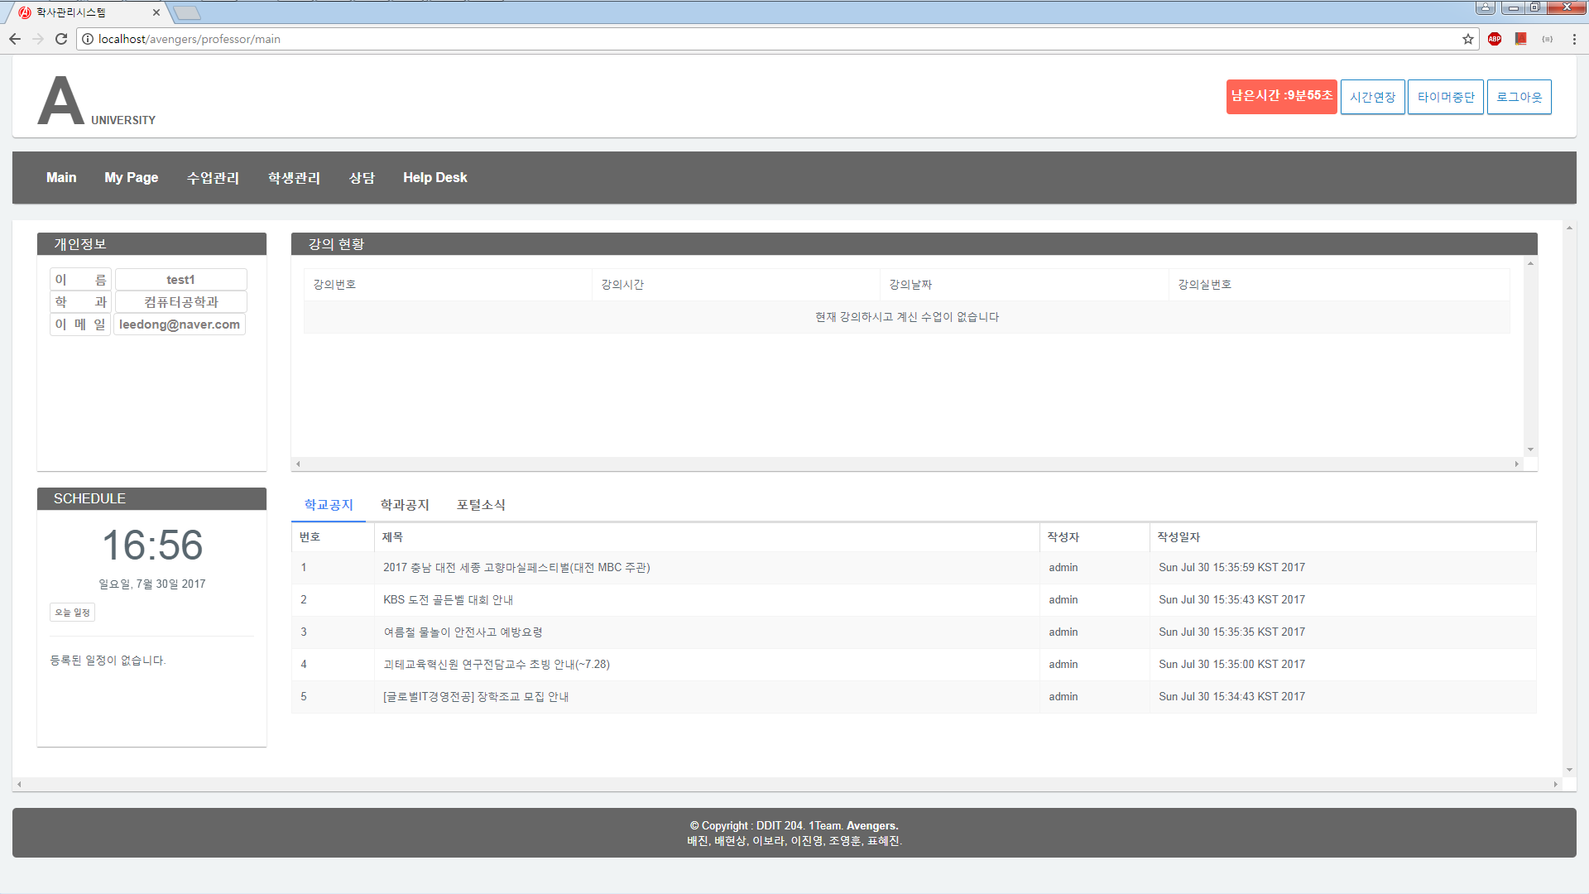
Professor
Academic Management System
5
Main in professors’ view
- Professors check their current situation, schedule in this page.
- Professors check current lecture situation.
- Professors checks academic portal news and notice board including their department news.

Slide 22
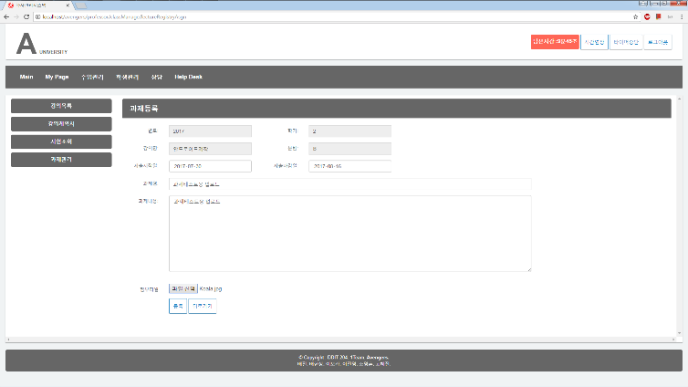
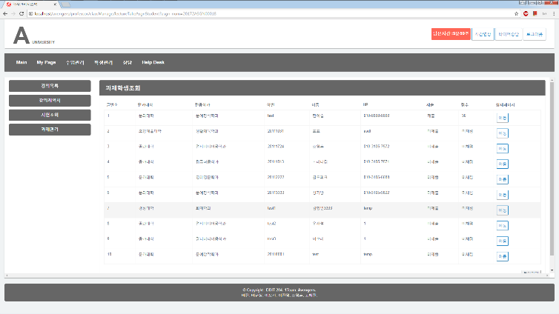
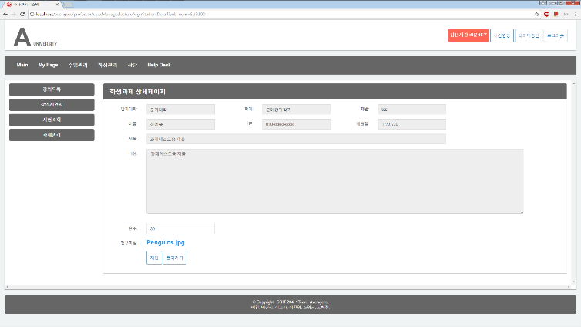
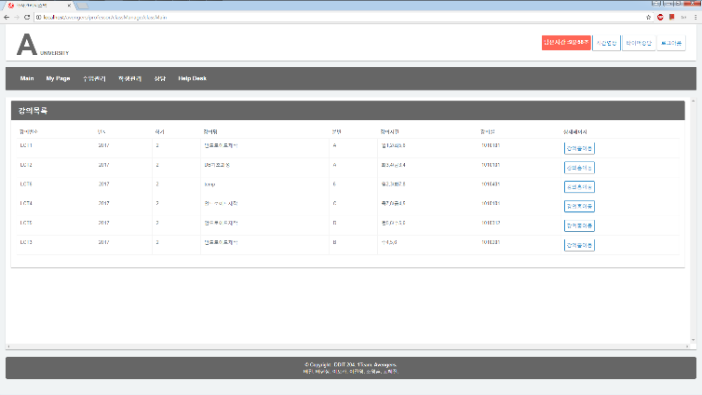
Professor
6
7
Registering assignments
Grading and Searching
Professor registers and submits
assignments through detail page.
Professor grades after student submitted
their assignments.
8
9
Detail page of assignment
Lecture List
Professor checks details of assignments.
Professor checks lecture list and manages assignments
and the test though detail page.

Slide 23
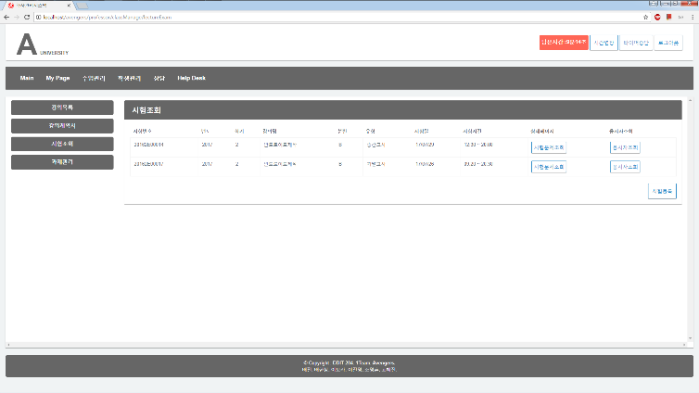
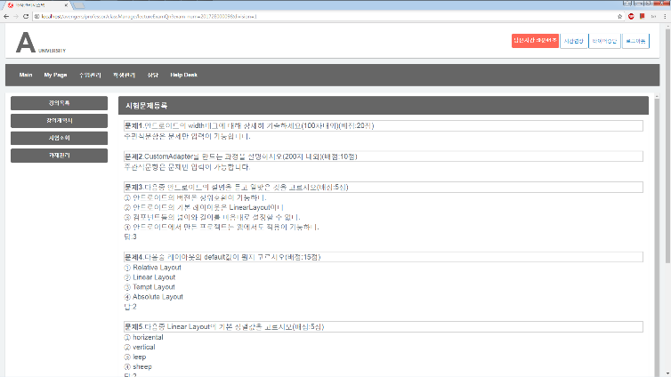
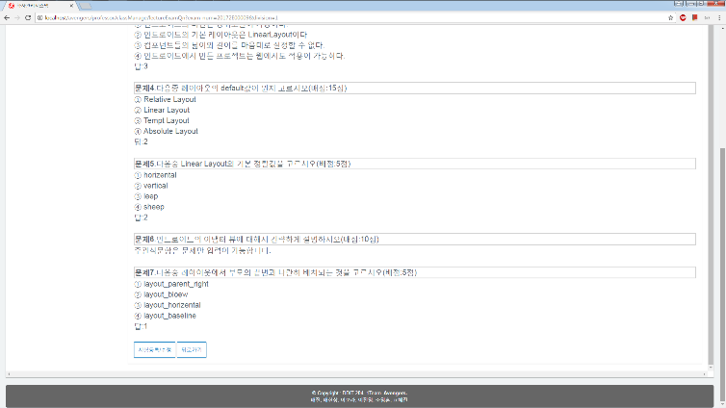
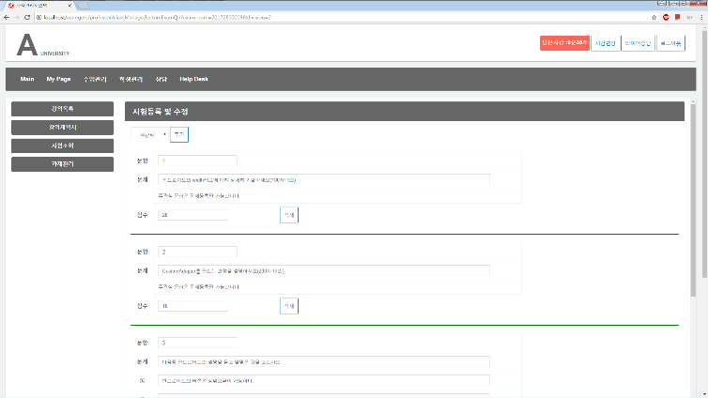
Professor
10
11
Test List
Test List of multiple choice type
- Professor registers and modify the test
Professor registers the test type of
multiple choice and the result.
12
13
Auto Grading
Test List of essay question
Assignments by students are graded automatically.
Professor registers the test of
essay choice type and the result.

Slide 24
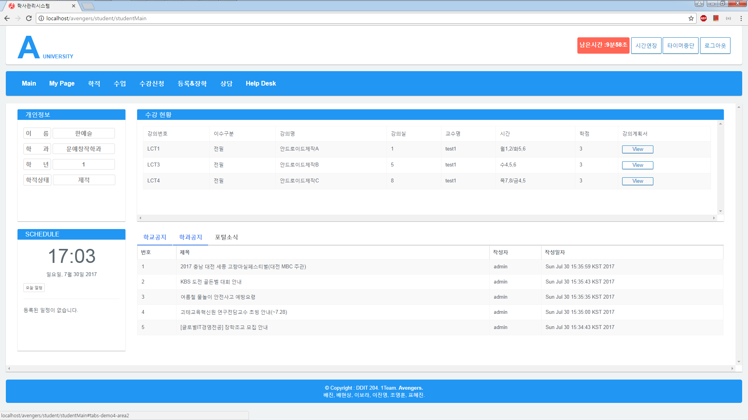
Student
Academic Management System
14
Main in student view
- Students check their status and information and academic schedule in this page.
- Students check their lecture list and the status.
- Students check and register academic and portal/ their department notice.

Slide 25
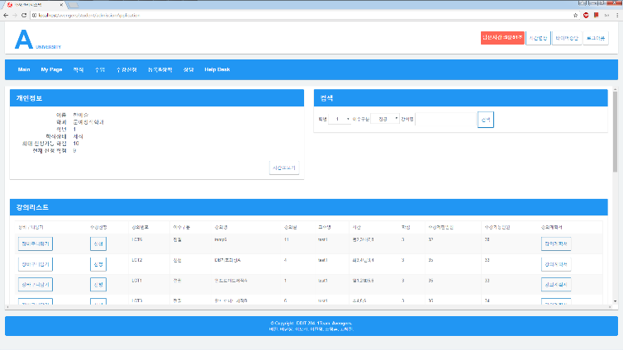
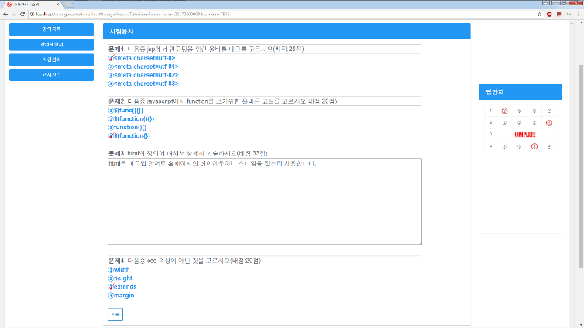
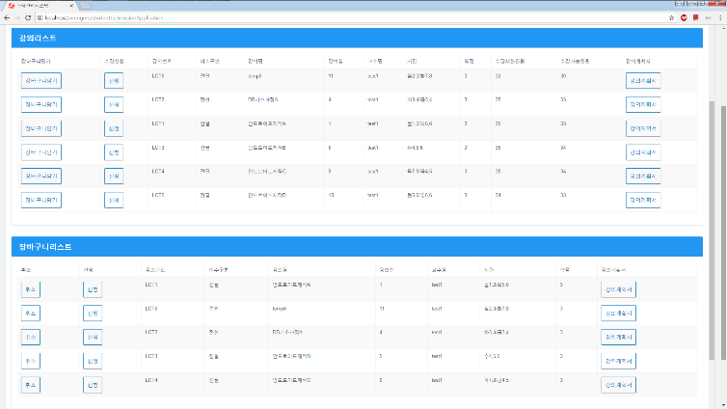
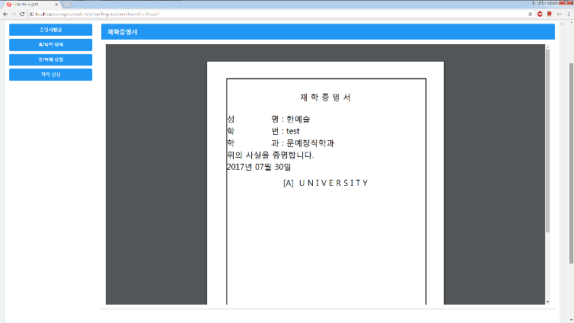
Student
15
16
Registering for courses
Test Page
Students register for courses in this page when
it comes to the course registration period.
Students take a test by licking detail page.
17
18
Course Basket
Issuing a student certification
Students save their courses they’d like to register
During Course registration period
Issuing certificates of graduate and enrollment.

Slide 26
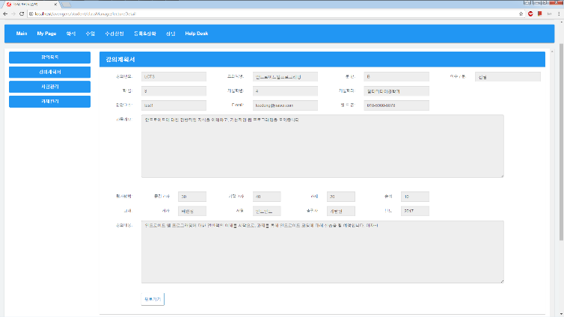
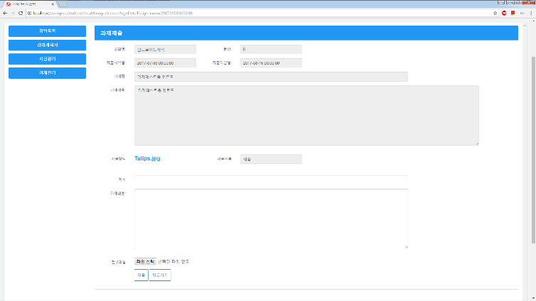
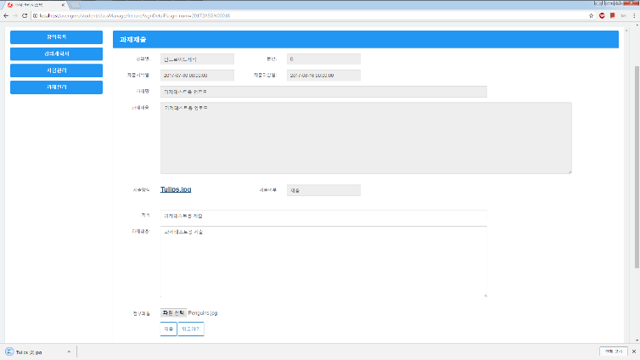
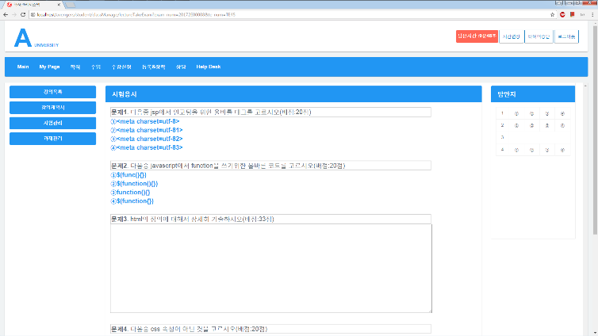
학생화면
19
20
Syllabus
Submitting Assignments
Students search syllabus of their course
by clicking the subject title.
Students check and submit assignments by clicking
detail button of subject title.
21
22
File Download for Assignments
Test
Students check assignments and download
related file in this page by clicking the subject title.
Students take test by clicking the subject title.

Slide 27
01
SMART TRASH BIN
OCT 22, 2018 ~ NOV 8, 2018(About 3 weeks)
I made automatic trash bin with ultrasonic sensor using C and Arduino Uno board.

Slide 28
Smart Trash Bin
Main function
I participated in
Ultrasonic sensor senses movement within 30 cm and opens up its cover and shut it after 4 seconds
coding with C and assemble every parts of trash bin and put them together

Slide 29
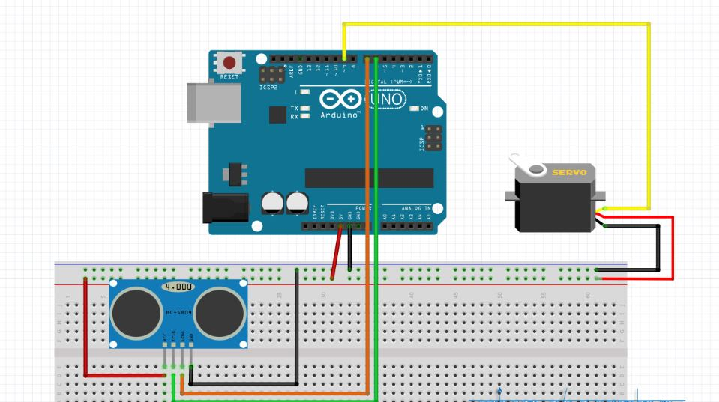
Smart Trash Bin
TOOLS
Uno board
C
Servo motor
Ultrasonic Sensor

Slide 30
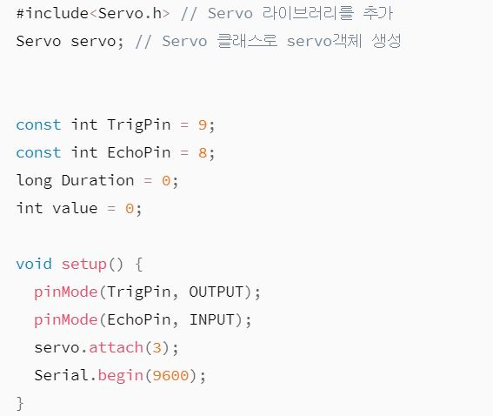
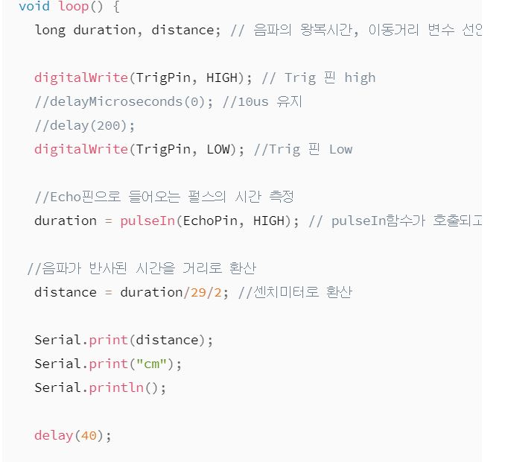
Smart Trash Bin
Smart Trash Bin
SMART TRASH BIN
SOURCE CODE
1
2
Defining tools
Loop logic
Define servo object for servo motor and
trigger/echo pin for ultrasonic sensor.
- Serial monitor shows its distance per second.
- Functions to activate
servo motor and sensor
And serial monitor to show current distance
Between sensor and movement.

Slide 31
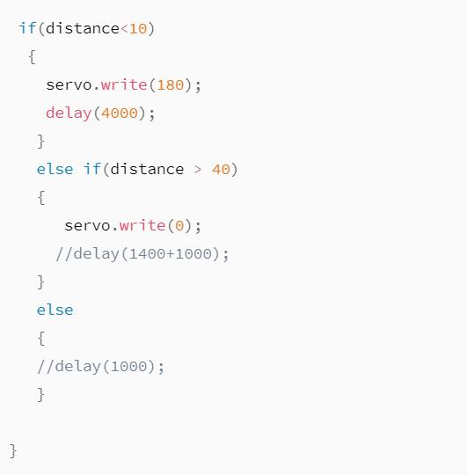
Smart Trash Bin
Smart Trash Bin
SMART TRASH BIN
SOURCE CODE
3
Business Logic
Created logic to operate servo motor and
Ultrasonic sensor with If statement.

Slide 32
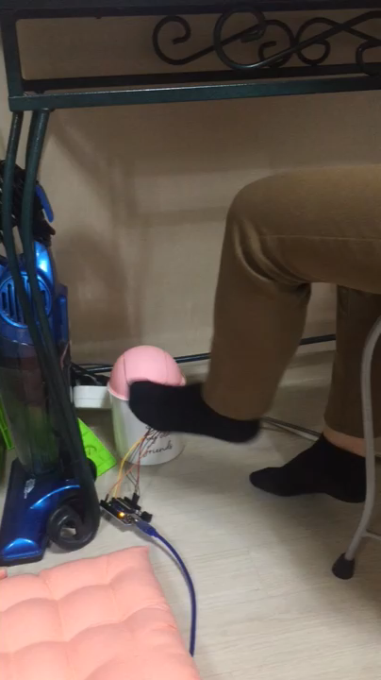
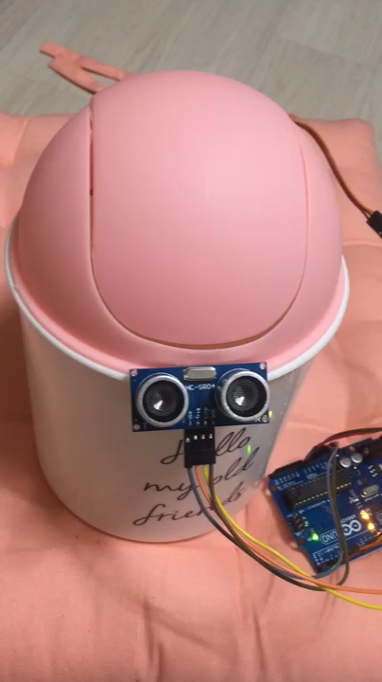
Smart Trash Bin
Smart Trash Bin
SMART TRASH BIN
video
4
Video
It opens up as the ultrasonic sensor senses movement within 10cm
and closes after few seconds.

Slide 33
Thank You For Reading!

